Slide 1
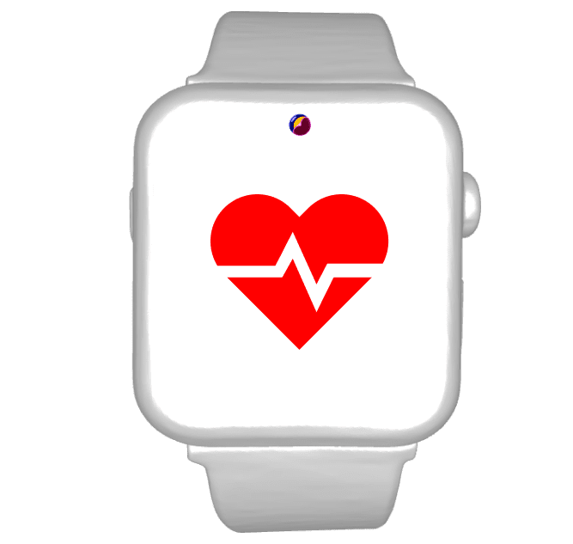
INTRODUCING
HEART WATCH
POWERED BY DREAM CODERS

Slide 2
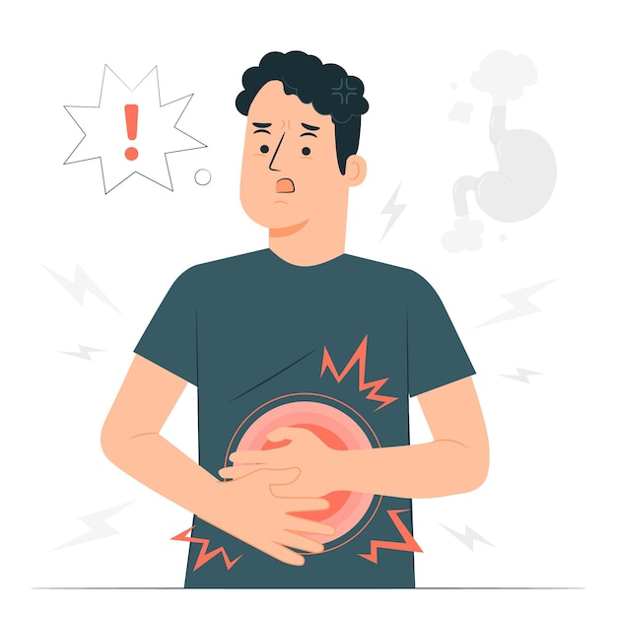
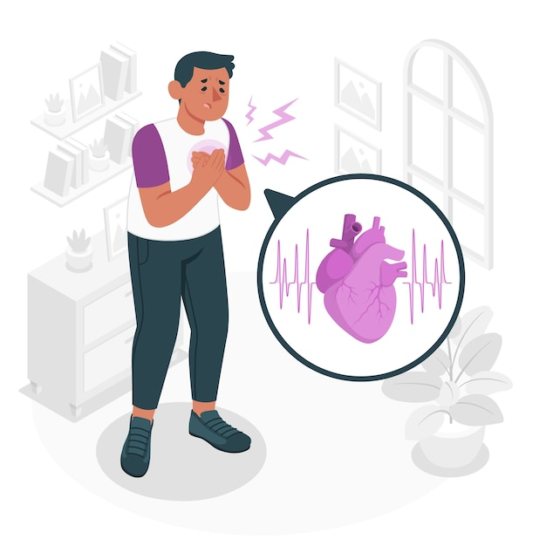
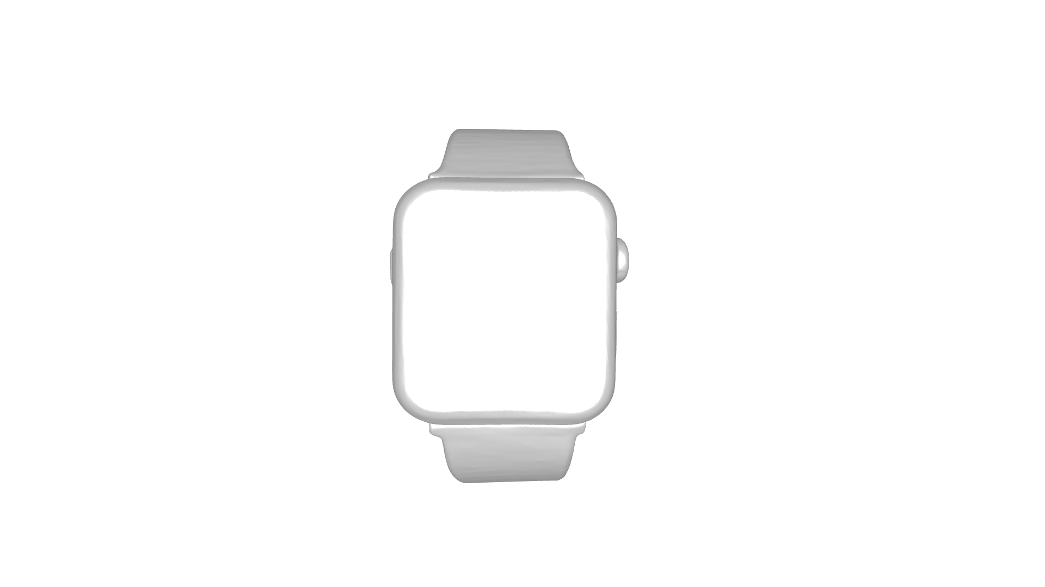
PROBLEM STATEMENT
“77% of the population associates heart pain with heart attacks, leading to mental distress and confusion with ulcer symptoms.”
Many older adults suffer from ulcers, with many losing their lives due to misdiagnosis or confusion between heart disease and ulcers. This mismanagement leads to unnecessary fears and anxiety, highlighting the urgent need for a reliable, budget-friendly tool. Such a device should provide realtime health monitoring, accurate diagnosis, and timely intervention, offering assurance and support to the elderly while boosting their confidence and overall well-being.
This
||
That
3

Slide 3
SOLUTION OVERVIEW
Our ML model senses the PROTEINS from the body analyzed through the wrist skin.
It collects the data in real time mode and constantly checking the health.
It provide the confidence score for the prediction with accuracy and percentage.
From this, a person having health issue are being identified at the earlier stage and used to give the knowledge about what the person is going through.
It boosts up the confidence to the elderly people.
Scroll below for the detailed unique works and implementations..
Scroll down know more about me
4

Slide 4
METHODOLOGY & APPROACH
Collecting the required dataset for ulcer and heart attack.
Improving self trainable model adding the sample from the real person as the data to the dataset.
Build the model that differentiate these two using the information given from the wrist watch.
WEARABLE
WRISTWATCH
METHOD
Designing and integration of model with the sensors in the watch.
Testing the model across different input.
Rebuilding the confidence percentage with at most accuracy.
Every-thing on your wrist
5

Slide 5
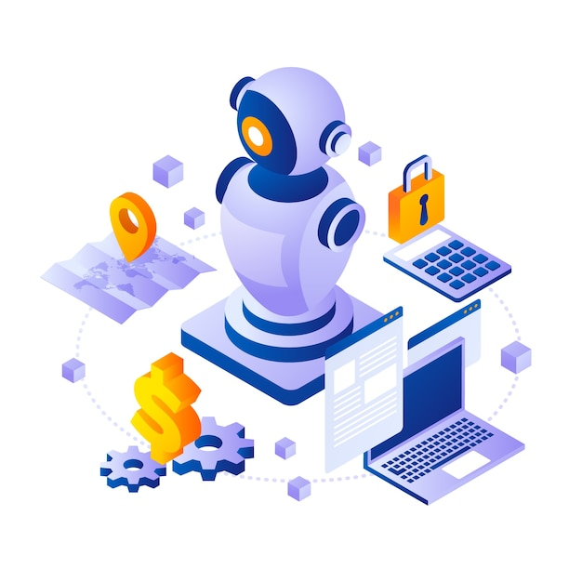
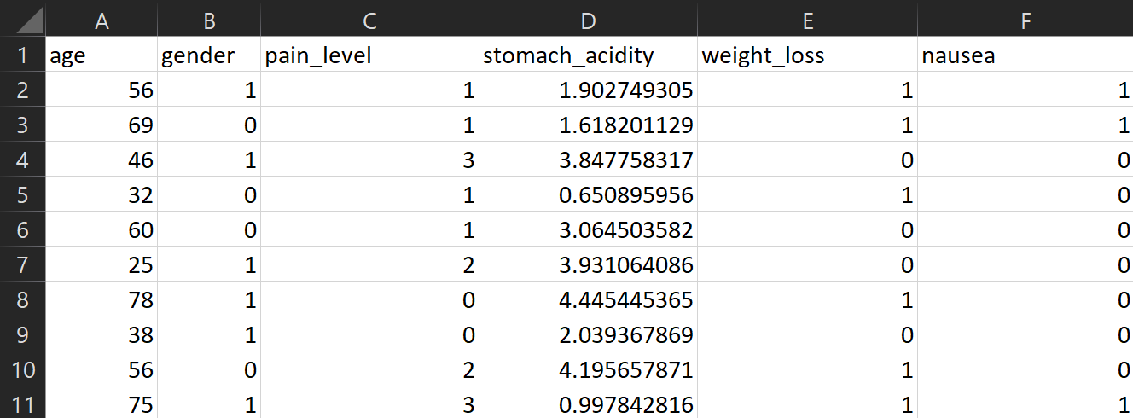
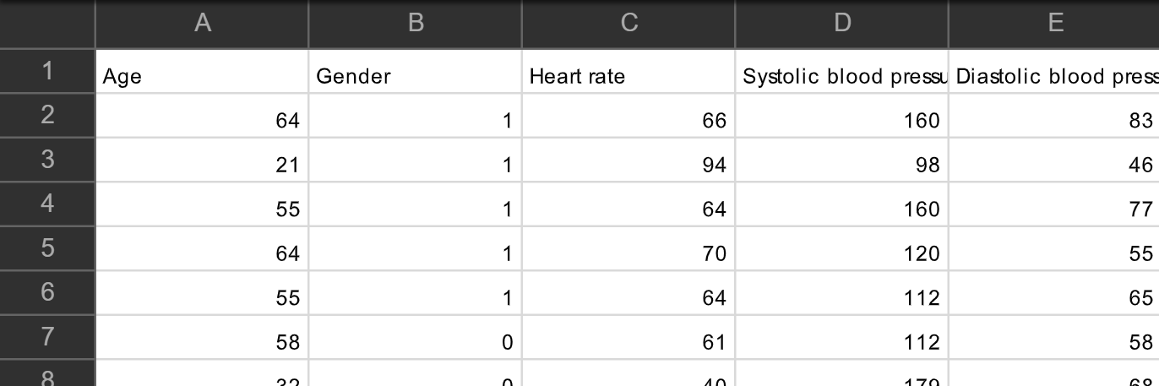
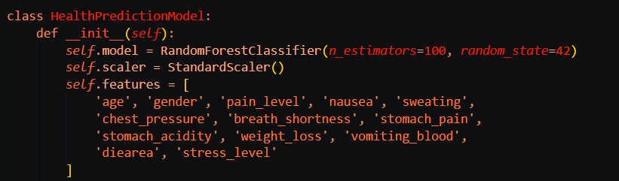
Data-Collection
Data : click here
Model-Build
This dataset deal with the heart attack analysis of the patient. This provides the model to differentiate the heart beats, pressure and pain level to discover the limit of the confidence. Such intentions were trained to the model to produce the accurate results.
Data for Ulcer
Preview
This dataset deal with the Basic Knowledge of the inputs and the types of person affected by ulcer. The model trained on this will find the ulcer with the accuracy of more than 96.7%. This powerful data with Randomforest algorithm make this confidence positive.
This Model will able to identify the symptoms are indicating ulcer or the heart attack. The data is provided to the database and used for alerting, and confidence boost.
Preview
Data : click here
Data for Heart Attack
Code-Preview
6

Slide 6
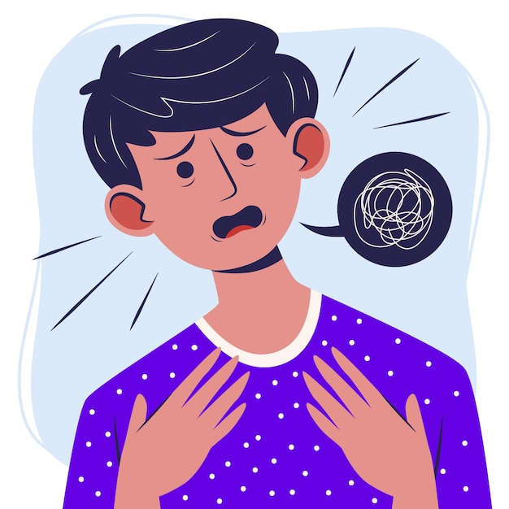

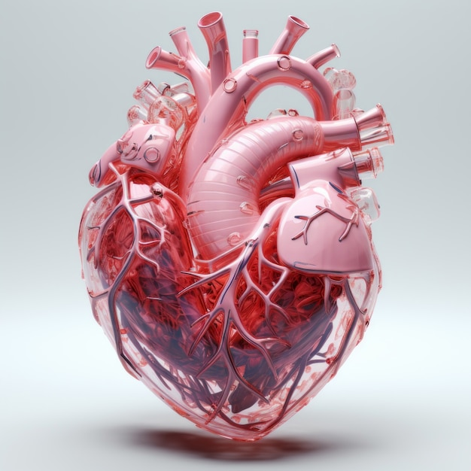
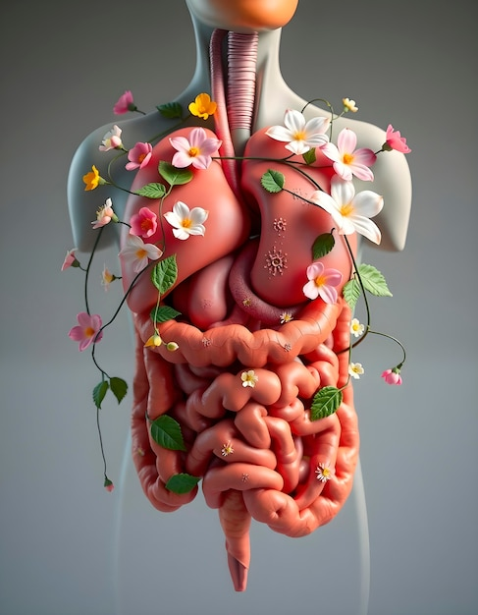
OUR SOLUTION
During the heart pain our body produces the proteins to cure the pain. The heart pain cause for the different reasons ie.. Ulcer, heart attack. With the synthesis of different types of proteins in our body, to fight against the foreign bodies. These proteins are seen by us as the early detectors of the ulcer or the heart attack. With the help of these proteins and some regular factors the watch integrated ml model will find out the disease the person is affected with.
Our model detects the protein generation from the body and cares the proteins in the blood flow.
The Confusion of the people will
tend to be cured by out machine.
The various factors for detecting ULCER:
Pain level
Stomach acidity
Stress level
nausea
Stomach pain
Weight loss
The various factors for detecting ATTATCK:
Protein FABP3
Age
Sweating
Chest pressure
Breath shortness
Blood Pressure
This integration of the watch model will help the people to know more about their health.
FABP3
Fatty acid Binding Protein
TNF-α
Tumor Necrosis Factor-alpha
Attack
Ulcer
7

Slide 7

Build with sci-kit learn framework, a random forest classifying model. Provide with the dozens of ulcer and attack datasets.
The real time collecting data are again send to the original dataset of the already saved model.
This makes efficient.
This model analyses the proteins the sensors given as the input. The data gets classified and returns the confidence score.
The excess symptoms with the proteins are classified and double check the provided result with the confidence score.
Medi-Me
8

Slide 8
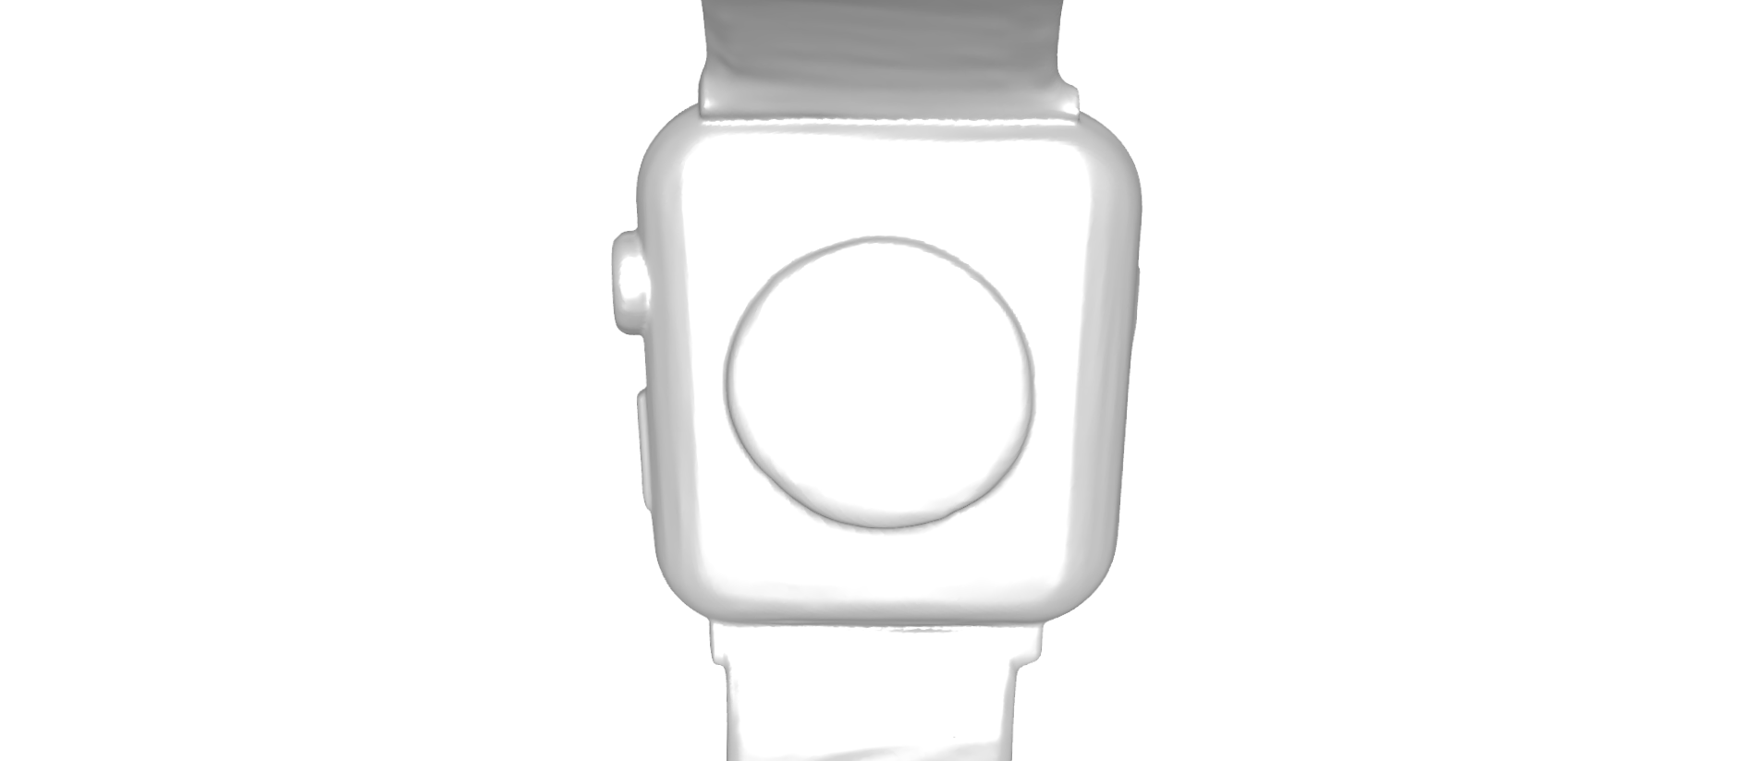

DESIGN OF HARDWARE
FRONT
REAR
The front base contains Medi Me app packs with integrated ML model. The allowance of the 4k vivid display make the person to see clearer.
The rear part of the watch is designed to have the protein detecting chip and three types of lights.
The red light, green light and invisible light.
9

Slide 9
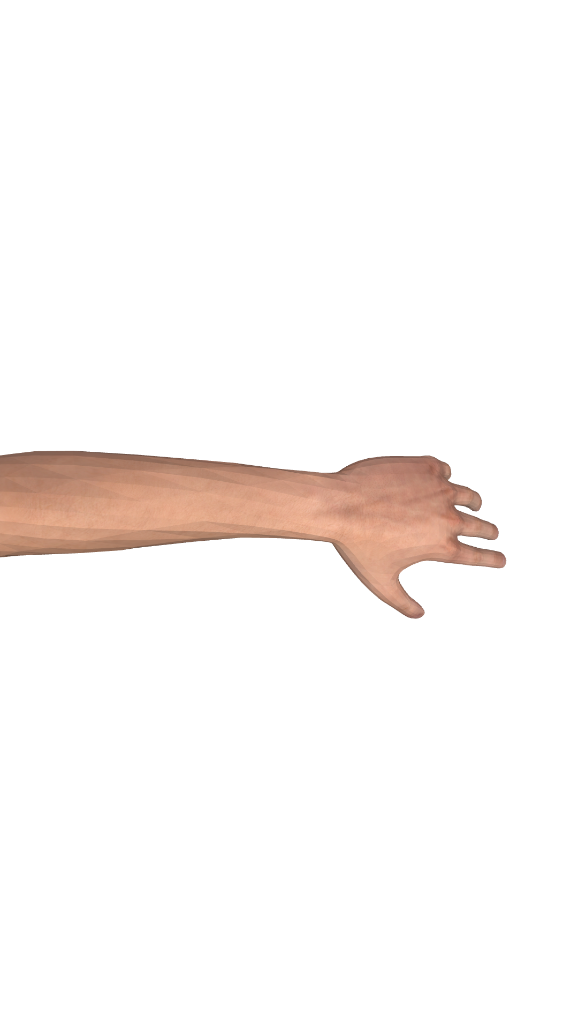
WORKING
The Real time Confidence Limit is always under surveillance. The need of worry for the elderly people is seamlessly relieved by the integration of ML and watch.
The Data collected from the body using the sensors are majorly protein data. These data is under the surveillance checking that they doesn’t exceed the certain threshold point. If it does the alert system turns. The prediction with the confidence score give the relief to the people who has our watch. This working function shares the information in the app itself. The data were simple and secured in the local place of the watch holder. At the worst situation an email alert is send to the people and nearby hospital also get alerted. This predicting scores check the blood flow, body pressure and complete analysis of the body through the proteins.
The integrated red, green and invisible light detects the vibrations from the flow of blood. The sensors detects the protein synthesis rate flow and report in the screen.
10

Slide 10
STACKS AND FRAMEWORKS
This project is made from the python stack. A full stack project with the frame works:
Frame Works | Version (>=)
Numpy | 1.24.0
Pandas | 2.0.0
Scikit-learn | 1.2.0
Flask | 2.3.0
Flask-cors | 4.0.0
Joblib | 1.3.0
Waitress | 3.0.2
HTML | 5.0.0
Css | 3.0.3
JavaScript | V8
11

Slide 11
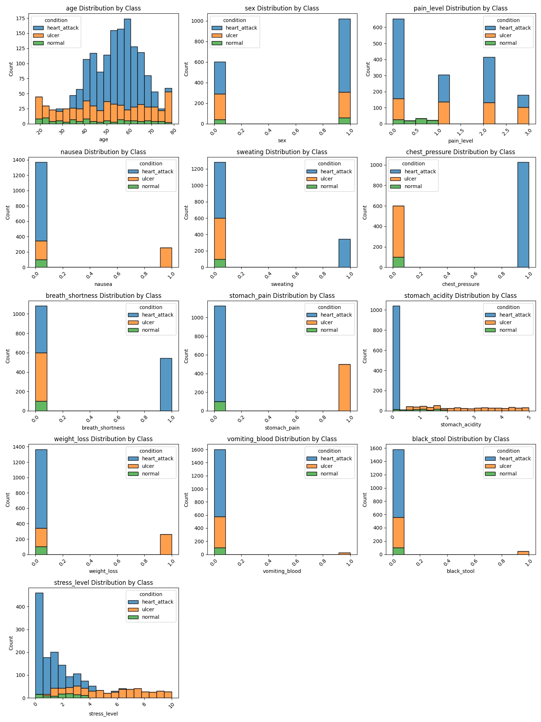
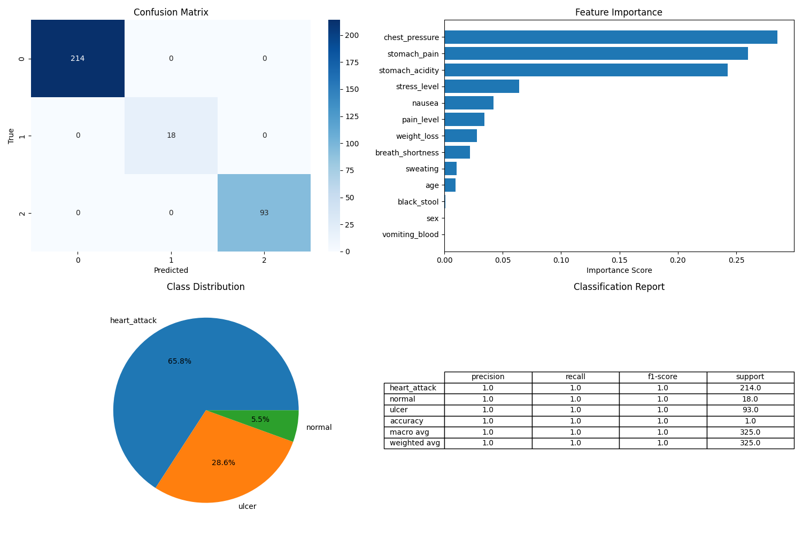
THE MULTI-MODEL ANALYSIS AND ACCURACY CHARTS
Distribution Visualization of HeartWatch
HeartWatch Prediction Visualizations
12

Slide 12
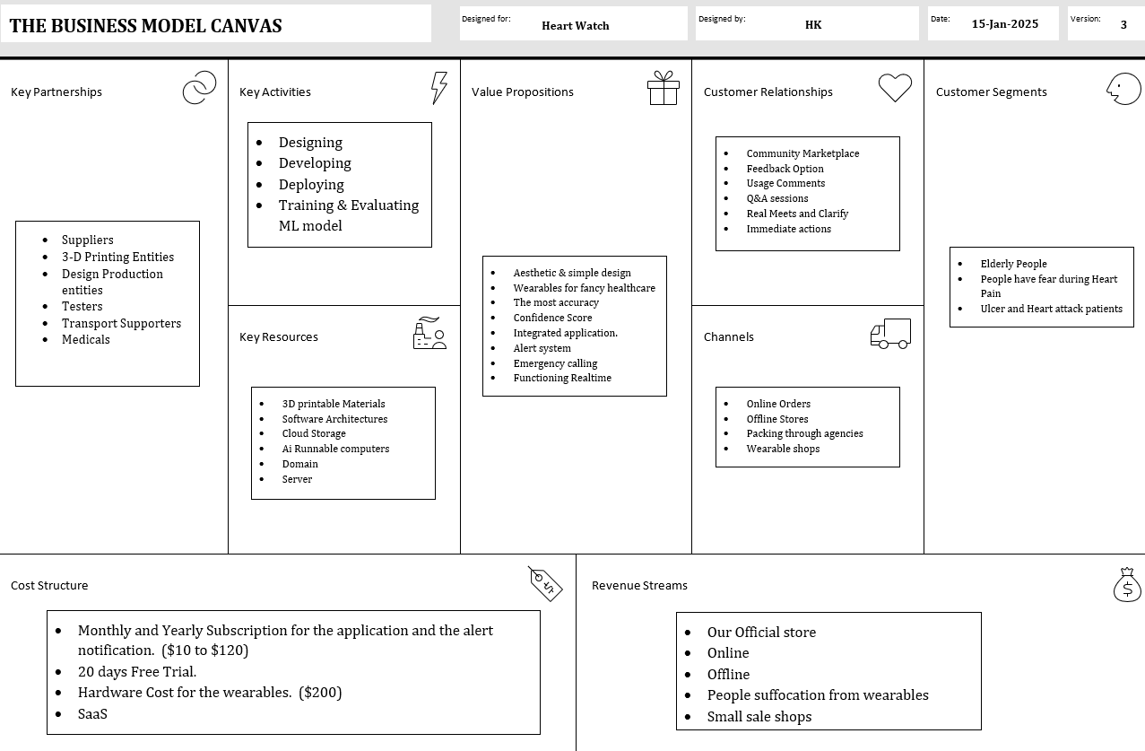
MARKETING ANALYSIS
13

Slide 13
WHAT CLIENT GET FROM US
The Confidence of what causes the clients heart pain will display to them in with the most percentage accuracy.
A health care wearable aesthetic and fashioned watch.
The protein synthesis detection and the rate of protein production will be available to the client.
Simple and secured data process from the client's local host help them in data privacy.
The foresight to the future even hours before the incoming disease are being monitored and alerted to them using the synthesis of the proteins.
The heart beat, heart pain, blood pressure, stress level with some of the factors are being monitored and managed into data.
These data are given to the client in the email and the alert system even alert the family members about the client’s health condition.
This real time machine model even contacts the nearest hospital for the emergency situation.
Overall, the client will get the fully functioning health care assistant whom the client can carry in their wrist watches in the fancy way.
14

Slide 14
FUTURE WORKS
A top graded iot with the slim appearance.
Consistently work in the efficiency of the model and upgrading the system.
Analyzing each and every proteins in the body for detecting every possible dangers.
The synthesis are need to be monitored by high powered model in future.
15

Slide 15
THANK YOU ! !
16

